Slide 1
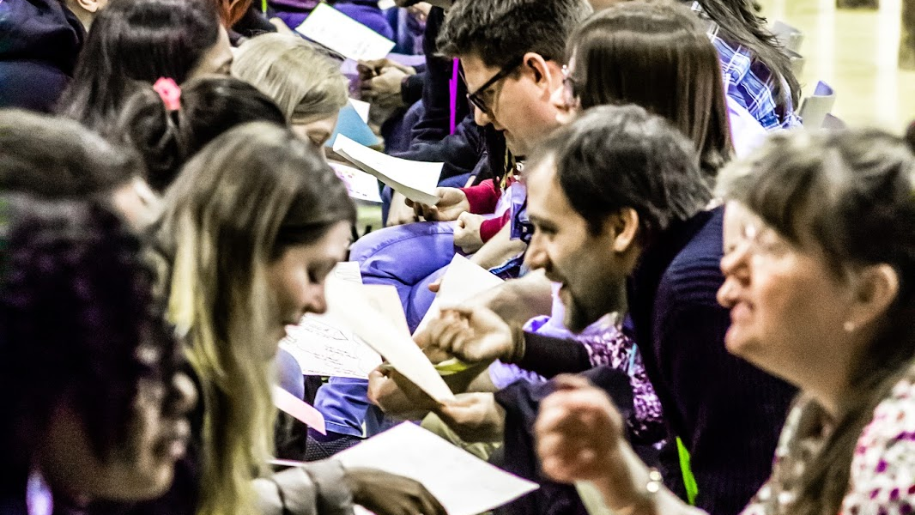
Speed Meet

Slide 2

Speed Meet
Rotate every 5 minutes
(to your left)

Slide 3
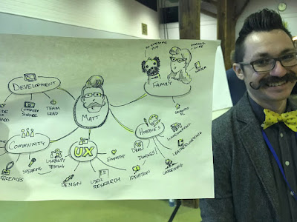
Mindmaps

Slide 4
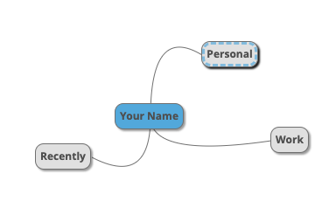
I tend to chat to strangers
For example, when in line at a supermarket or bank or a speed meet.

Slide 5
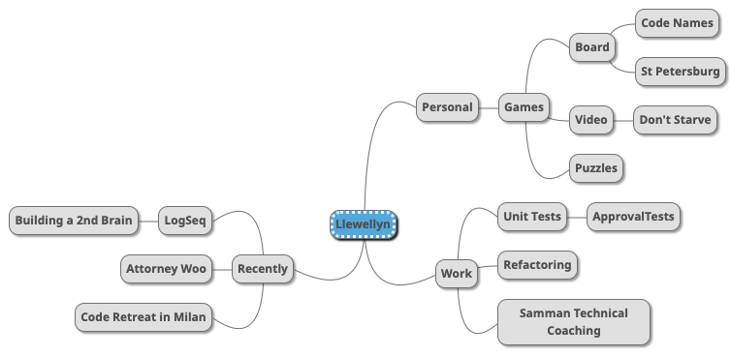
I tend to chat to strangers
For example, when in line at a supermarket or bank or a speed meet.

